Slide 1
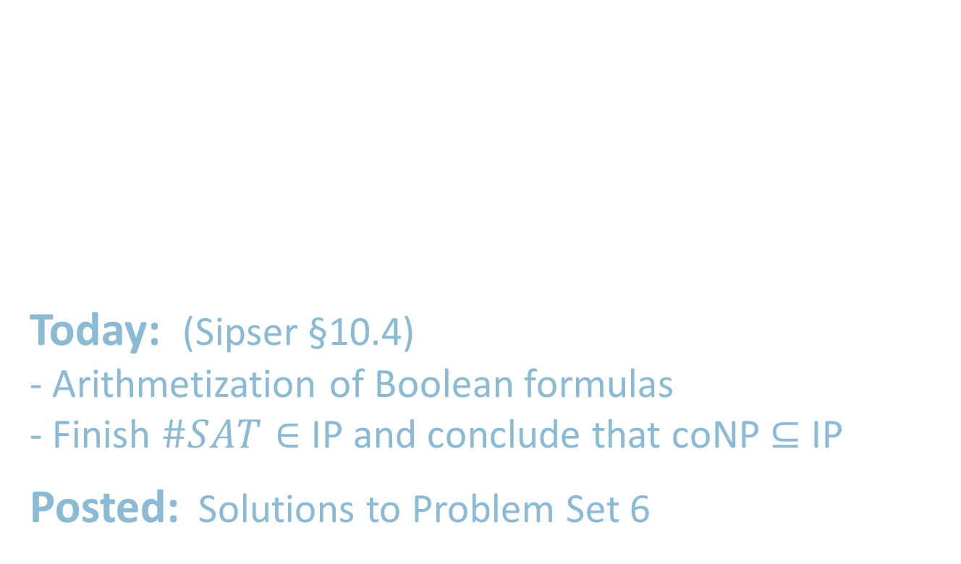
18.404/6.840 Lecture 26
Last time: - Interactive Proof Systems
- The class IP
- Graph isomorphism problem, $\overline{ISO}∈$ IP
- $\#SAT∈$ IP (part 1)
Today: (Sipser §10.4) - Arithmetization of Boolean formulas
- Finish $\#SAT∈$ IP and conclude that coNP $⊆$ IP
Posted: Solutions to Problem Set 6

Slide 2




Review: Interactive Proofs
Two interacting parties
Verifier (V): Probabilistic polynomial time TM
Prover (P): Unlimited computational power
Both P and V see input $w$.
They exchange a polynomial number of polynomial-size messages.
Then V accepts or rejects.
Defn: Pr[ (V$↔\text{P}$) accepts $w$ ] = probability that V accepts when V interacts with P, given input $w$.
Defn: IP $=\left\{A\right|$ for some V and P (This P is an “honest” prover)
$w∈A →$Pr [ (V $↔$ P) accepts $w$ ] $≥2/3$
$w∉A →$for any prover $\tilde{\text{P}}$ Pr [ (V $↔$ $\tilde{\text{P}}$) accepts $w$ ] $≤1/3$ }
Equivalently: IP $=\left\{A\right|$ for some V
$w∈A → ∃$P Pr [ (V $↔$ P) accepts $w$ ] $≥2/3$
$w∉A → ∄$P Pr [ (V $↔$ P) accepts $w$ ] $≥ 1/3$ }
Think of $\tilde{\text{P}}$ as a “crooked” prover trying to make V accept when it shouldn’t.
Here, we emphasize how P is similar to the certificate for NP-languages.
An amplification lemma can improve the error probability from $1/3$ to $1/{2^{poly \left(n\right)}}$

Slide 3
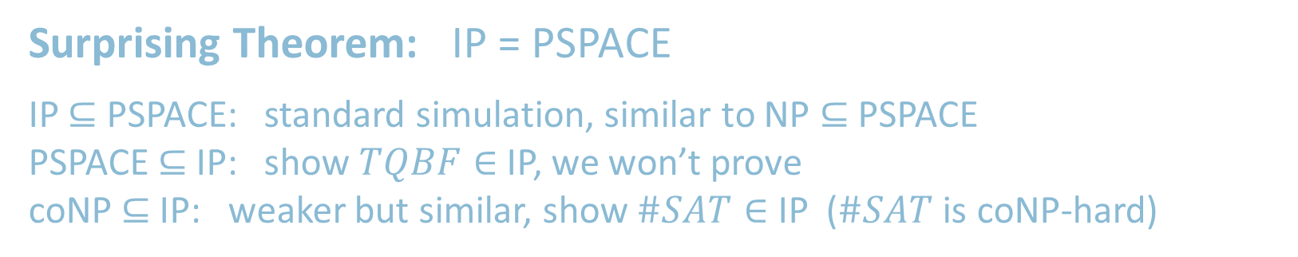

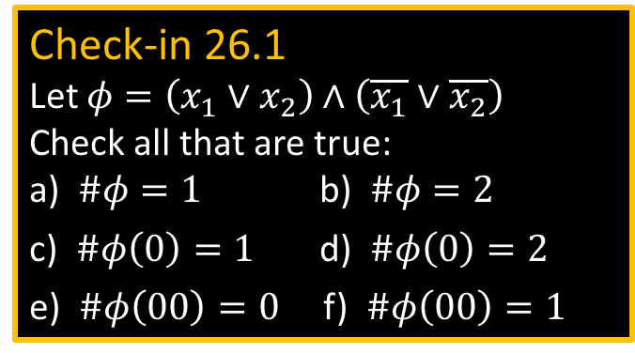


coNP $⊆$ IP
Surprising Theorem: IP = PSPACE
IP $⊆$ PSPACE: standard simulation, similar to NP $⊆$ PSPACE
PSPACE $⊆$ IP: show $TQBF∈$ IP, we won’t prove
coNP $⊆$ IP: weaker but similar, show $\#SAT∈$ IP ($\#SAT$ is coNP-hard)
$\#SAT=\left\{〈φ,k〉\right|$Boolean formula $φ$has exactly $k$ satisfying assignments$\}$
Theorem: $\#SAT∈$ IP
Proof: First some notation. Assume $φ$ has $m$ variables $x_{1},…, x_{m}$.
Let $φ(0)$ be $φ$ with $x_{1}=0$ (0 substituted for $x_{1}$) 0 = False and 1 = True.
Let $φ(a_{1}…a_{i})$ be $φ$ with $x_{1}=a_{1}$ , … , $x_{i}=a_{i}$ for $a_{1},…, a_{i}∈\left\{0,1\right\}$.
Call $a_{1},…, a_{i}$ presets. The remaining $x_{i+1}, …, x_{m}$ stay as unset variables.
Let $\#φ$ = the number of satisfying assignments of $φ$.
Let $\#φ\left(0\right)$ = the number of satisfying assignments of $φ\left(0\right)$.
Let $\#φ(a_{1}…a_{i})$ = the number of satisfying assignments of $φ(a_{1}… a_{i})$
Check-in 26.1
Let $φ=\left(x_{1}∨x_{2}\right)∧\left(\overline{x_{1}}∨\overline{x_{2}}\right)$ Check all that are true:
a) $\#φ=1$ b) $\#φ=2$
c) $\#φ\left(0\right)=1$ d) $\#φ\left(0\right)=2$
e) $\#φ\left(00\right)=0$ f) $\#φ\left(00\right)=1$
Two identities
1. $\#φ(a_{1}…a_{i})=$ $\#φ\left(a_{1}…a_{i}0\right)+\#φ\left(a_{1}…a_{i}1\right)$
2. $\#φ(a_{1}…a_{m})=$ $φ(a_{1}… a_{m})$
Check-in 26.1

Slide 4



























$\#SAT∈$ IP – 1st attempt
Theorem: $\#SAT∈$ IP
Proof: Protocol for V and (the honest) P on input $〈φ,k〉$
0) P sends $\#φ$; V checks $k=\#φ$
1) P sends $\#φ\left(0\right)$, $\#φ\left(1\right)$; V checks $\#φ=\#φ\left(0\right)+\#φ\left(1\right)$
2) P sends $\#φ\left(00\right)$, $\#φ\left(01\right)$, $\#φ\left(10\right)$, $\#φ\left(11\right)$; V checks $\#φ\left(0\right)=\#φ\left(00\right)+\#φ\left(01\right)$
$\#φ\left(1\right)=\#φ\left(10\right)+\#φ\left(11\right)$
$⋮$
$m$) P sends $\#φ\left(0⋯0\right)$, … , $\#φ\left(1⋯1\right)$; V checks $\#φ\left(0⋯0\right)=\#φ\left(0⋯00\right)+\#φ\left(0⋯01\right)$
$⋮$
V checks $\#φ\left(1⋯1\right)=\#φ\left(1⋯10\right)+\#φ\left(1⋯11\right)$
$m+1$) V checks $\#φ\left(0⋯0\right)=φ\left(0⋯0\right)$
$⋮$
$\#φ\left(1⋯1\right)=φ\left(1⋯1\right)$
V accepts if all checks are correct. Otherwise V rejects.
red = incorrect
$$k≠\#φ$$
$$m−1$$
$$k$$
$$m$$
$$m−1$$
=
$$\#φ$$
$$\#φ$$
+
$$m$$
$$\#φ\left(0\right)$$
$$\#φ\left(1\right)$$
$$\#φ\left(1\right)$$
+
+
$$\#φ\left(00\right)$$
$$\#φ\left(01\right)$$
$$\#φ\left(10\right)$$
$$\#φ\left(10\right)$$
$$\#φ\left(11\right)$$
$$⋮$$
$$⋮$$
$$⋮$$
Problem: Exponential. Will fix.
$$\#φ\left(0⋯0\right)$$
$$⋯$$
$$\#φ\left(1⋯1\right)$$
=
≠
=
$$φ\left(0⋯0\right)$$
$$⋯$$
$$φ\left(1⋯1\right)$$

Slide 5

























Idea for fixing $\#SAT∈$ IP protocol
$$k$$
$$k$$
=
=
$$\#φ$$
$$\#φ$$
+
$$\#φ\left(0\right)$$
$$\#φ\left(1\right)$$
$$\#φ\left(r_{1}\right)$$
+
+
Non-Boolean assignments to the variables of $φ$
$$\#φ\left(00\right)$$
$$\#φ\left(01\right)$$
$$\#φ\left(10\right)$$
$$\#φ\left(11\right)$$
$$\#φ\left(r_{1}r_{2}\right)$$
+
+
+
+
$$⋮$$
$$⋮$$
$$⋮$$
$$\#φ\left(0⋯0\right)$$
$$⋯$$
$$\#φ\left(1⋯1\right)$$
$$\#φ\left(r_{1}⋯r_{m}\right)$$
=
=
=
$$φ\left(0⋯0\right)$$
$$⋯$$
$$φ\left(1⋯1\right)$$
$$φ\left(r_{1}⋯r_{m}\right)$$

Slide 6



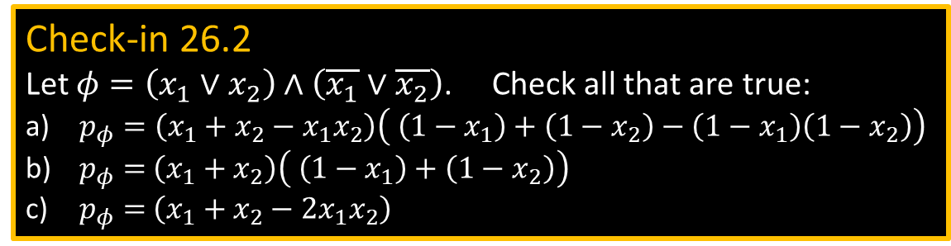




Arithmetizing Boolean formulas
Simulate $∧$ and $∨$ with $+$ and $×$
$a∧b → a×b=ab$
$\overline{a} → \left(1−a\right)$
$a∨b → a+b−ab$
$φ →$ $p_{φ}$
degree($p_{φ}$) $≤\left|φ\right|$
Let $𝔽_{q}=\left\{0,1,…, q−1\right\} \text{for} \text{prime} q>2^{m}$ be a finite field ($+$, $×$ mod $q$) and let $a_{1},…, a_{i}∈𝔽_{q}$
Let $φ\left(a_{1}…a_{i}\right)=p_{φ}$ where $x_{1}$⋯$x_{i}=a_{1}⋯a_{i}$ and remaining $x_{i+1}, …, x_{m}$ stay as unset variables.
$$\#φ(a_{1}… a_{i})= \sum{ φ(a_{1}… a_{m})}$$
Let
Important: For Boolean $a_{1}… a_{i}$ the values of $φ\left(a_{1}…a_{i}\right)$ and $\#φ(a_{1}… a_{i})$ are unchanged from the previous definition.
We have extended these functions to non-Boolean values
Check-in 26.2
Let $φ=\left(x_{1}∨x_{2}\right)∧\left(\overline{x_{1}}∨\overline{x_{2}}\right)$. Check all that are true:
$p_{φ}=\left(x_{1}+x_{2}−x_{1}x_{2}\right)\left( \left(1−x_{1}\right)+\left(1−x_{2}\right)−\left(1−x_{1}\right)\left(1−x_{2}\right)\right)$
$p_{φ}=$ $\left(x_{1}+x_{2}\right)\left( \left(1−x_{1}\right)+\left(1−x_{2}\right)\right)$
$p_{φ}=$ $\left(x_{1}+x_{2}−2x_{1}x_{2}\right)$
$$a_{i+1},…, a_{m}∈\{0,1\}$$
identities still true
1. $\#φ(a_{1}…a_{i})=$ $\#φ\left(a_{1}…a_{i}0\right)+\#φ\left(a_{1}…a_{i}1\right)$
2. $\#φ(a_{1}…a_{m})=$ $φ(a_{1}… a_{m})$
Check-in 26.2

Slide 7


Slide 8





$\#SAT∈$ IP – version 1
Theorem: $\#SAT∈$ IP
Proof: Protocol for V and (the honest) P on input $〈φ,k〉$
0) P sends $\#φ$; V checks $k=\#φ$
P sends $\#φ\left(z\right)$ as a polynomial in $z$ [sends coefficients – recall deg $p_{φ}≤|φ|$ ]
V checks $\#φ=\#φ\left(0\right)+\#φ\left(1\right)$ [by evaluating polynomial for $\#φ\left(z\right)$ ]
V sends random $r_{1}∈𝔽_{q}$ [P needs to show $\#φ\left(r_{1}\right)$ is correct]
P sends $\#φ\left(r_{1}z\right)$ as a polynomial in $z$
V checks $\#φ(r_{1})=\#φ\left(r_{1}0\right)+\#φ\left(r_{1}1\right)$ [by evaluating polynomial for $\#φ\left(r_{1}z\right)$ ]
V sends random $r_{2}∈𝔽_{q}$ [P needs to show $\#φ\left(r_{1}r_{2}\right)$ is correct]
$⋮$
$m$) P sends $\#φ\left(r_{1}⋯r_{m−1}z\right)$ as a polynomial in $z$
V checks $\#φ(r_{1}⋯r_{m−1})=\#φ\left(r_{1}⋯r_{m−1}0\right)+\#φ\left(r_{1}⋯r_{m−1}1\right)$
V sends random $r_{m}∈𝔽_{q}$
$m+1$) V checks $\#φ\left(r_{1}⋯r_{m}\right)=φ\left(r_{1}⋯r_{m}\right)$
V accepts if all checks are correct. Otherwise V rejects.
1) P sends $\#φ\left(0\right)$, $\#φ\left(1\right)$; V checks $\#φ=\#φ\left(0\right)+\#φ\left(1\right)$
[P needs to show $\#φ\left(z\right)$ is correct ]
$$\#φ(a_{1}… a_{i})= \sum{ φ(a_{1}… a_{m})}$$
Recall
$$a_{i+1},…, a_{m}∈\{0,1\}$$

Slide 9

























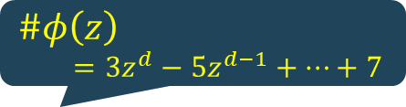



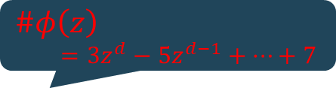












$\#SAT∈$ IP – version 2
Input $〈φ,k〉$
Verifier checks
Prover sends
Verifier sends
$$\#φ=k$$
$$\#φ$$
$$k$$
$\#φ$
$\#φ$
+
$\#φ\left(z\right)$
$=3z^{d}−5z^{d−1}+⋯+7$
$\#φ\left(z\right)$
$=3z^{d}−5z^{d−1}+⋯+7$
$$\#φ\left(0\right)$$
$$\#φ\left(1\right)$$
$$\#φ\left(1\right)$$
$$\#φ\left(r_{1}\right)$$
$$\#φ\left(r_{1}\right)$$
$$r_{1}$$
+
$$\#φ\left(r_{1}0\right)$$
$\#φ\left(r_{1}z\right)$ = $⋯$
$$\#φ\left(r_{1}0\right)$$
$$\#φ\left(r_{1}1\right)$$
If $k$ is correct, V will accept.
If $k$ is wrong, V probably will reject, whatever P does.
$\#φ\left(r_{1}z\right)$ = $⋯$
$$\#φ\left(r_{1}r_{2}\right)$$
$$\#φ\left(r_{1}r_{2}\right)$$
$$r_{2}$$
+
$\#φ\left(r_{1}r_{2}z\right)$ = $⋯$
$\#φ\left(r_{1}r_{2}z\right)$ = $⋯$
$$\#φ\left(r_{1}r_{2}0\right)$$
$$\#φ\left(r_{1}r_{2}1\right)$$
$$\#φ\left(r_{1}r_{2}1\right)$$
$$⋮$$
$$\#φ\left(r_{1}⋯r_{m−1}\right)$$
$$\#φ\left(r_{1}⋯r_{m−1}\right)$$
+
$$\#φ\left(r_{1}⋯r_{m−1}0\right)$$
$$\#φ\left(r_{1}⋯r_{m−1}1\right)$$
$\#φ\left(r_{1}⋯r_{m−1}z\right)$ = $⋯$
$$\#φ\left(r_{1}⋯r_{m−1}1\right)$$
$\#φ\left(r_{1}⋯r_{m−1}z\right)$ = $⋯$
$$\#φ\left(r_{1}⋯r_{m}\right)$$
$$\#φ\left(r_{1}⋯r_{m}\right)$$
$$r_{m}$$
accept
$$=$$
reject
$$φ\left(r_{1}⋯r_{m}\right)$$

Slide 10












$\#SAT∈$ IP – correctness
Claim: (1) $〈φ,k〉∈\#SAT→$Pr [ (V $↔$ P) accepts $〈φ,k〉$ ] $≥2/3$
(2) $〈φ,k〉∉\#SAT→$for any prover $\tilde{\text{P}}$ Pr [ (V $↔$ $\tilde{\text{P}}$) accepts $〈φ,k〉$ ] $≤1/3$ }
Proof: (1) All Verifier checks are correct (with the honest P) so V always accepts (Pr = 1).
(2) If V accepts then $\#φ\left(r_{1}⋯r_{m}\right)$ is correct even though $\#φ$ is wrong
So $\#φ\left(r_{1}⋯r_{i}\right)$ is correct at some first stage $i$.
$$⋮$$
$$\#φ\left(r_{1}⋯r_{i−1}\right)$$
+
$$\#φ\left(r_{1}⋯r_{i−1}z\right)$$
$$\#φ\left(r_{1}⋯r_{i−1}z\right)$$
$$\#φ\left(r_{1}⋯r_{i−1}0\right)$$
$$\#φ\left(r_{1}⋯r_{i−1}1\right)$$
$$\#φ\left(r_{1}⋯r_{i}\right)$$
Pr [agree at random $r_{i}∈𝔽_{q}$] $≤{degree}/q≤{\left|φ\right|}/{2^{m}}$
Agreement is necessary for $\#φ\left(r_{1}⋯r_{i}\right)$ to be correct
So P is “lucky” at stage $i$ if agreement occurs.
Pr [agree at some stage $i$] $≤{m\left|φ\right|}/{2^{m}}≤1/m$ for large $m$
$$⋮$$
Therefore, for any prover $\tilde{\text{P}}$ Pr [ (V $↔$ $\tilde{\text{P}}$) accepts $〈φ,k〉$ ] $≤1/3$ }

Slide 11
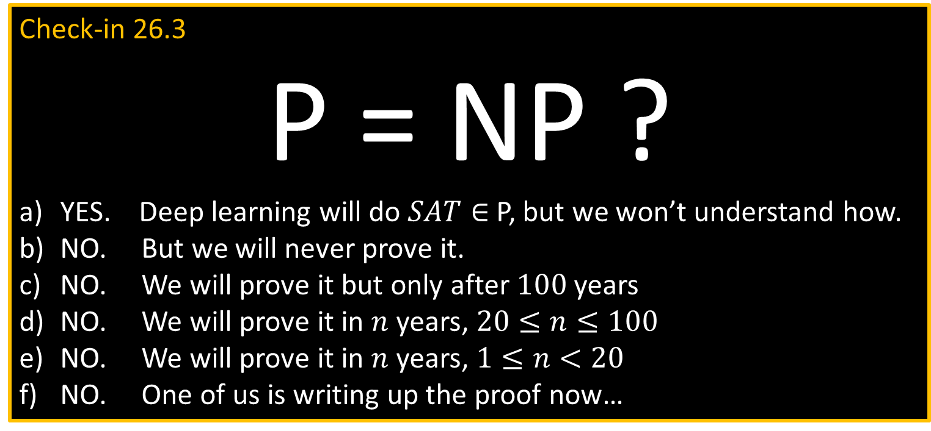
Check-in 26.3
P = NP ?
YES. Deep learning will do $SAT∈$ P, but we won’t understand how.
NO. But we will never prove it.
NO. We will prove it but only after $100$years
NO. We will prove it in $n$ years, $20≤n≤100$
NO. We will prove it in $n$ years, $1≤n<20$
NO. One of us is writing up the proof now…
Check-in 26.3

Slide 12


Quick review of today
Finished $\#SAT∈$ IP and coNP $⊆$ IP
Additional subjects:
18.405/6.841 Advanced complexity F2021
18.425/6.875 Cryptography F2021
6.842 Randomness and Computation ?
Good luck on the final!
Best wishes for the holidays and the New Year!

